Slide 1
Logistic Regression
Machine Learning

Slide 2
Logistic Regression
Logistic Regression is a supervised machine learning algorithm used for binary classification problems.
Despite its name, it is a classification algorithm, not a regression algorithm.
It models the probability that a given input belongs to a particular class using the logistic (sigmoid) function.

Slide 3
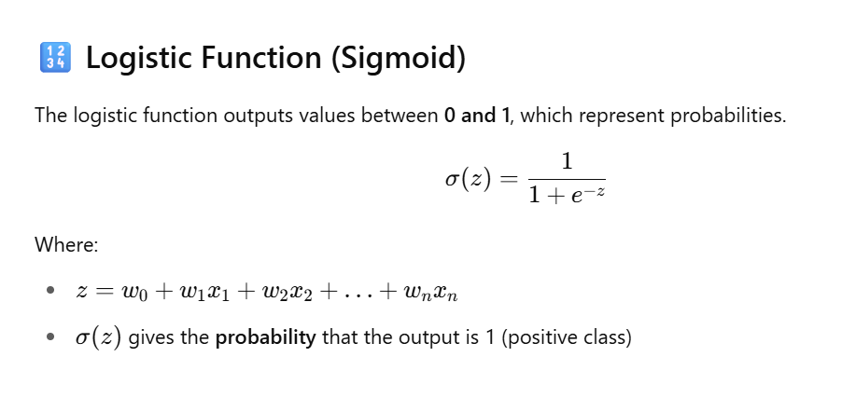

Slide 4
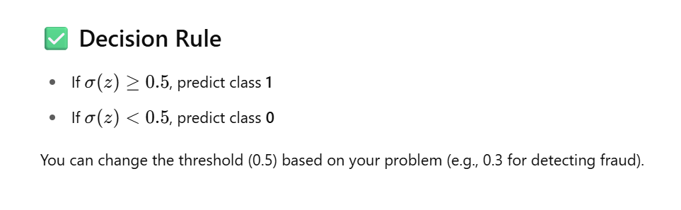

Slide 5
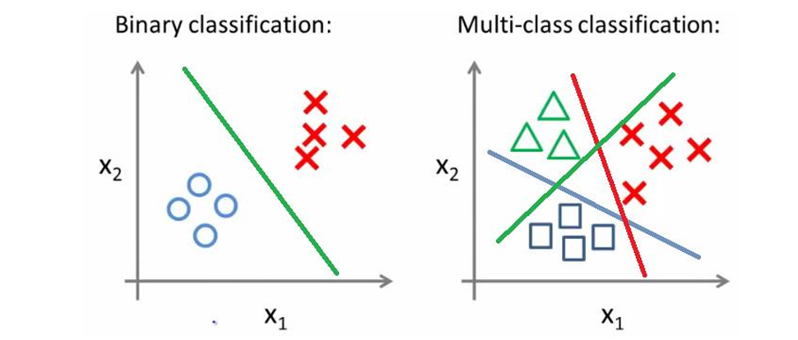

Slide 6
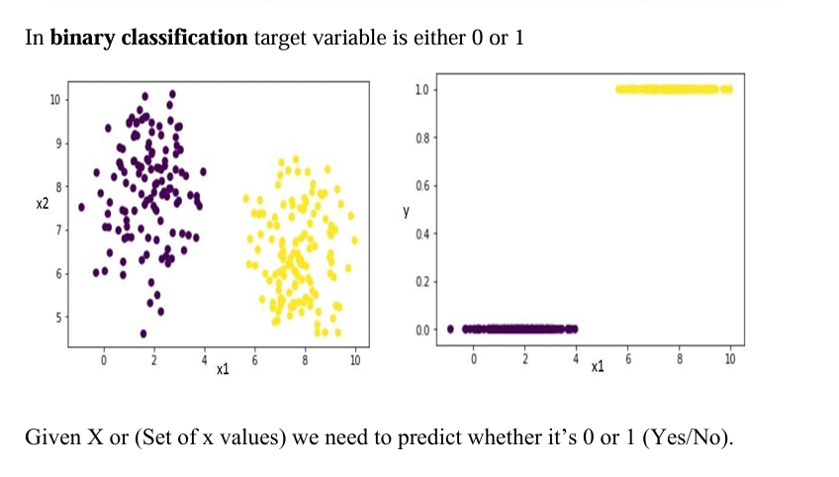

Slide 7
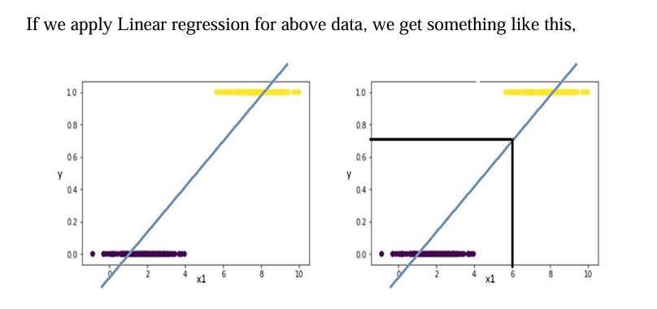

Slide 8
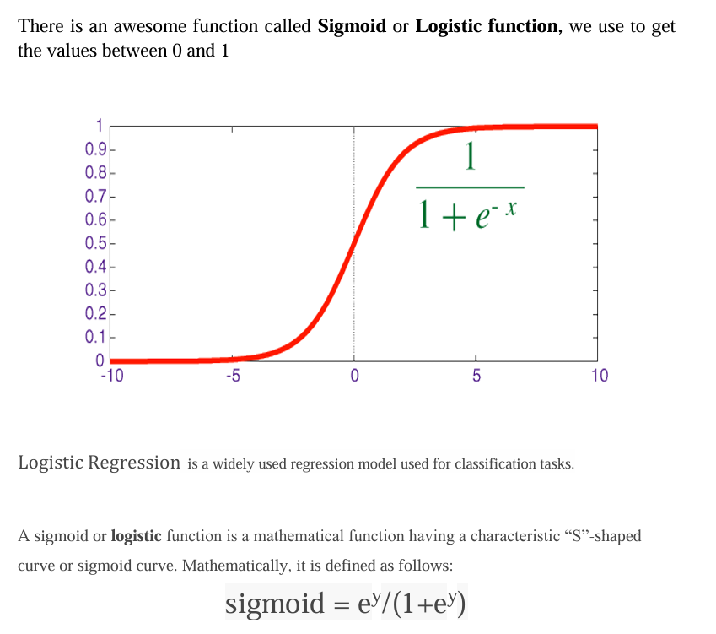

Slide 9
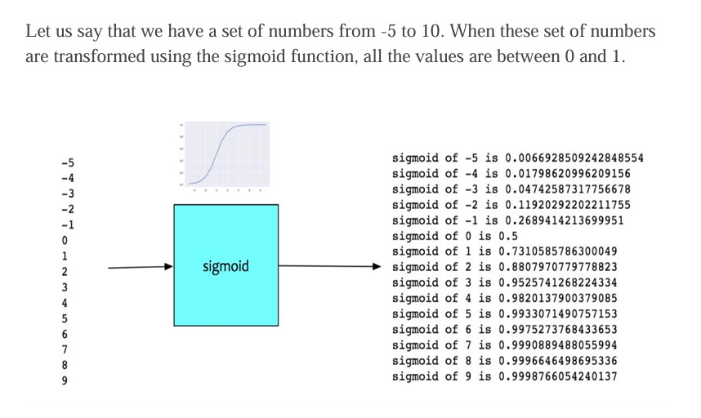

Slide 10
